Slide 1



MERN – ES6 + React
Module 14: React Advanced

Slide 2
Outline
Module 14
React hooks
useState
useEffect
useContext
React Forms
React Router
React Bootstrap

Slide 3
React Hooks
React Advanced
What is a Hook?
Hooks allow us to "hook" into React features such as state and other React features without writing a class
Hook Rules
Hooks can only be called inside React function components.
Hooks can only be called at the top level of a component.
Hooks cannot be conditional
Hooks will not work in React class components.

Slide 4
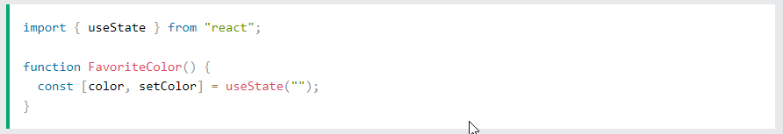
React useState Hook
React Advanced
What is useState hook?
The React useState Hook allows us to track state in a function component.
State generally refers to data or properties that need to be tracked in an application.
Initialize useState
We initialize our state by calling useState in our function component.
useState accepts an initial state and returns two values:
The current state.
A function that updates the state
What Can State Hold
The useState Hook can be used to keep track of strings, numbers, booleans, arrays, objects, and any combination of these!
We can create multiple state Hooks to track individual values
Tryit Editor
Tryit Editor
Tryit Editor

Slide 5
React useEffect Hooks
React Advanced
What is useEffect hook?
The useEffect Hook allows you to perform side effects in your components.
Some examples of side effects are: fetching data, directly updating the DOM, and timers.
useEffect runs on every render
useEffect accepts two arguments. The second argument is optional.
useEffect(<function>, <dependency>)
1. No dependency passed:
2. An empty array:
3. Props or state values:
useEffect(() => { //Runs on every render });
useEffect(() => { //Runs only on the first render }, []);
useEffect(() => { //Runs on the first render //And any time any dependency value changes }, [prop, state]);
Tryit Editor
Tryit Editor
Tryit Editor

Slide 6
React useContext Hook
React Advanced
What is React Context hook?
React Context is a way to manage state globally.
It can be used together with the useState Hook to share state between deeply nested components more easily than with useState alone.
Create Context
To create context, you must Import createContext and initialize it:
Context Provider
Wrap child components in the Context Provider and supply the state value.
Use the useContext Hook
In order to use the Context in a child component, we need to access it using the useContext Hook.
Tryit Editor Problem
Tryit Editor Solution

Slide 7
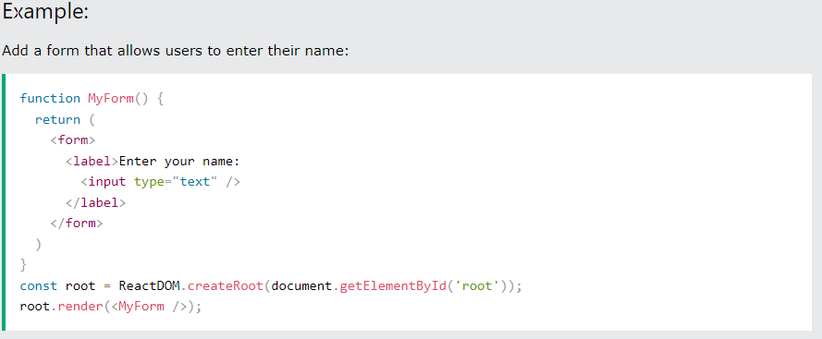
React Forms
React Advanced
Adding Forms in React
Just like in HTML, React uses forms to allow users to interact with the web page.

Slide 8
React Forms
React Advanced
Handling Forms
Handling forms is about how you handle the data when it changes the value or gets submitted.
In HTML, form data is usually handled by the DOM.
In React, form data is usually handled by the components.
When the data is handled by the components, all the data is stored in the component state.
We can use the useState Hook to keep track of each inputs value and provide a "single source of truth" for the entire application.
Tryit Editor useStae
Tryit Editor Multiple inputs

Slide 9
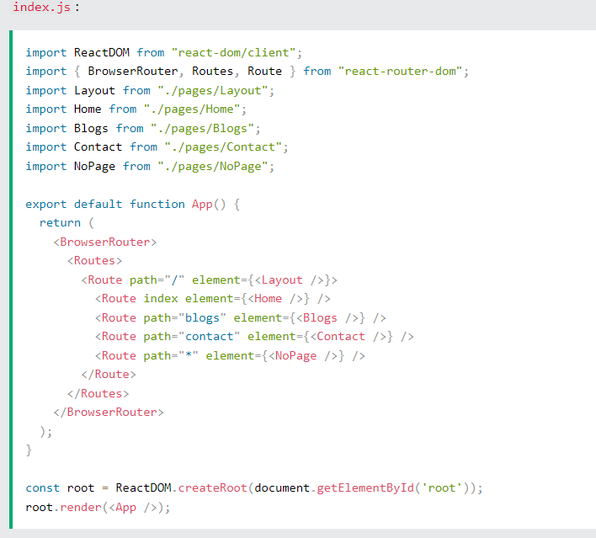
React Router
React Advanced
Folder Structure
Within the src folder, we'll create a folder named pages with several files:
src\pages\:
Layout.js
Home.js
Blogs.js
Contact.js
NoPage.js

Slide 10
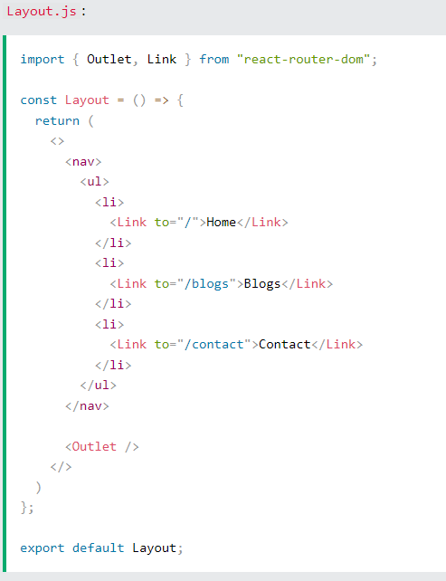
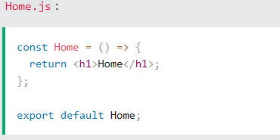
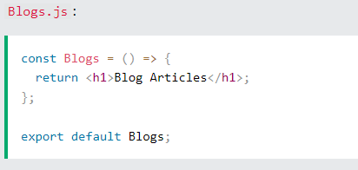
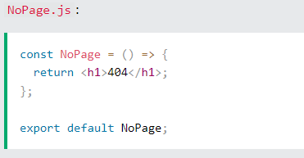
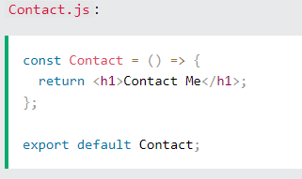
React Router
Pages / Components

Slide 11
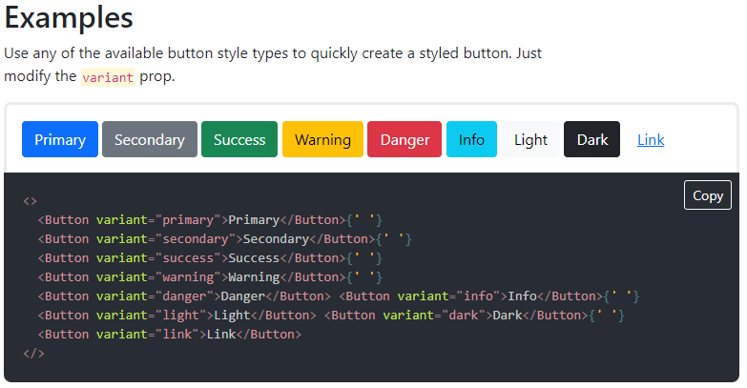
React Bootstrap
React Advanced
React-Bootstrap · React-Bootstrap Documentation

Slide 12
Summary
Module 14
React hooks
useState
useEffect
useContext
React Forms
React Router
React Bootstrap

